Slide 1
Recurrent Neural Networks (RNNs)
Deep Learning
Notes:
Introduce RNNs as a crucial component of deep learning, explaining their inspiration from the human brain and their ability to process sequential data. Provide examples of applications such as language modeling and speech recognition. Ask students to consider how RNNs can be used in real-world scenarios.

Slide 2
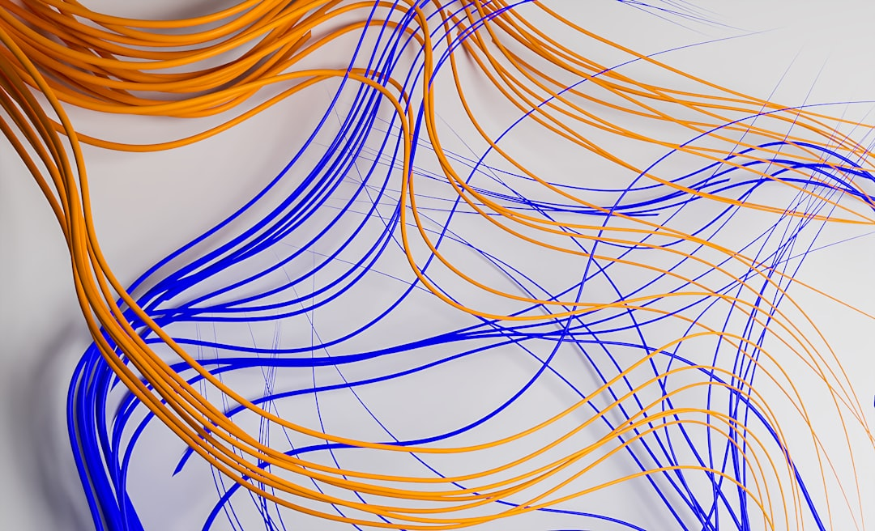
Architecture
Feedforward networks lack memory
RNNs introduce recurrent connections
Image_query: basic RNN architecture
Unfolds in time for computation
Uses hidden state for information
Simple RNN equation: h_t = tanh
Recurrent layers for deep models
Handles variable-length sequences
Supports many-to-one, one-to-many
Notes:
Explain the basic architecture of RNNs, highlighting the introduction of recurrent connections and the use of a hidden state to capture information over time. Discuss how this allows RNNs to handle sequential data and variable-length sequences. Provide examples of how this architecture is used in practice.

Slide 3
Mathematical Formulation
RNNs defined by recurrence relation
Involves input, output, hidden state
Activation functions for non-linearity
Backpropagation for training
Through time for sequential data
Gradient clipping for stability
Vanishing gradients problem
Exploding gradients issue
Regularization techniques applied
Notes:
Delve into the mathematical formulation of RNNs, discussing the recurrence relation, activation functions, and the challenges of training RNNs such as vanishing and exploding gradients. Explain how backpropagation through time is used for training and introduce techniques for addressing these challenges.

Slide 4
Training and Backpropagation Through Time
Training RNNs is computationally expensive
Backpropagation through time (BPTT) used
Unfolds RNN in time for computation
Computes gradients for weight updates
Truncated BPTT for efficiency
Real-time recurrent learning (RTRL)
BPTT variants for improved stability
Regularization techniques for generalization
Hyperparameter tuning for optimal performance
Notes:
Discuss the challenges of training RNNs and introduce backpropagation through time as a method for computing gradients. Explain the concept of unfolding the RNN in time and the variants of BPTT for improved efficiency and stability. Emphasize the importance of regularization and hyperparameter tuning for optimal performance.

Slide 5
Applications
Language modeling and text generation
Speech recognition systems
Time-series forecasting and prediction
Natural language processing tasks
Machine translation and localization
Sentiment analysis and opinion mining
Dialogue systems and chatbots
Music and audio generation
Biological sequence analysis
Notes:
Explore the various applications of RNNs, from language modeling and speech recognition to time-series forecasting and natural language processing tasks. Provide examples of how RNNs are used in practice and discuss their potential for future applications. Ask students to consider how RNNs could be applied to real-world problems.

Slide 6
Advantages and Limitations
Captures temporal relationships effectively
Handles sequential data with ease
Supports variable-length sequences
Enables dynamic system modeling
Challenging to train due to gradients
Vanishing and exploding gradients issues
Computationally expensive to train
Requires large amounts of data
Sensitive to hyperparameter tuning
Notes:
Summarize the advantages and limitations of RNNs, highlighting their ability to capture temporal relationships and handle sequential data. Discuss the challenges of training RNNs, including vanishing and exploding gradients, and the need for large amounts of data and careful hyperparameter tuning. Emphasize the importance of understanding these trade-offs when applying RNNs to real-world problems.

